Slide 1
JNCIS-ENT
Layer 2 switching and VLANs

Slide 2
Bridging Mechanisms 2
3
Fundamentals of Bridging / Switching

Slide 3
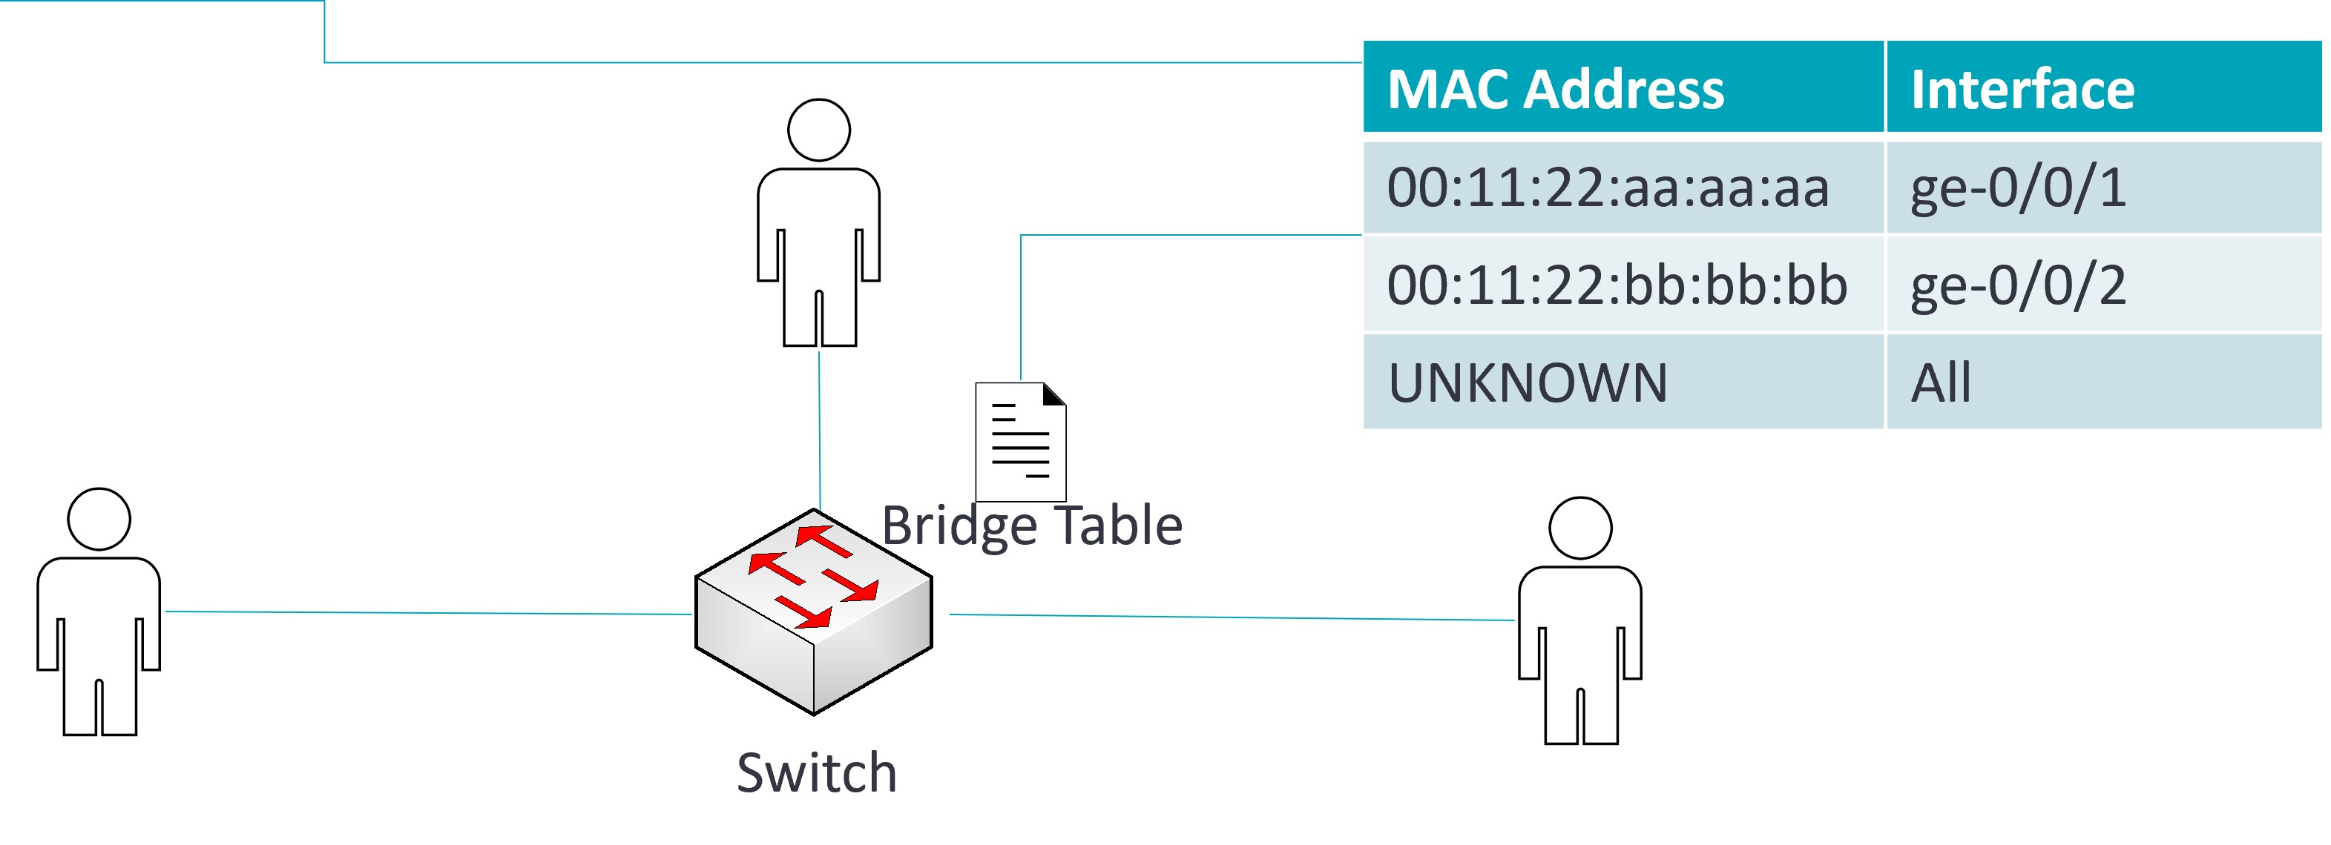
Bridging Mechanisms - Flooding
Flooding is used to ensure delivery of BUM traffic
Broadcast frames, Unknown destination unicast frames and Multicast frames
Flooding forwards the frame to all interfaces
Preamble
Destination Address
Source Address
Type
Data
FCS

Slide 4
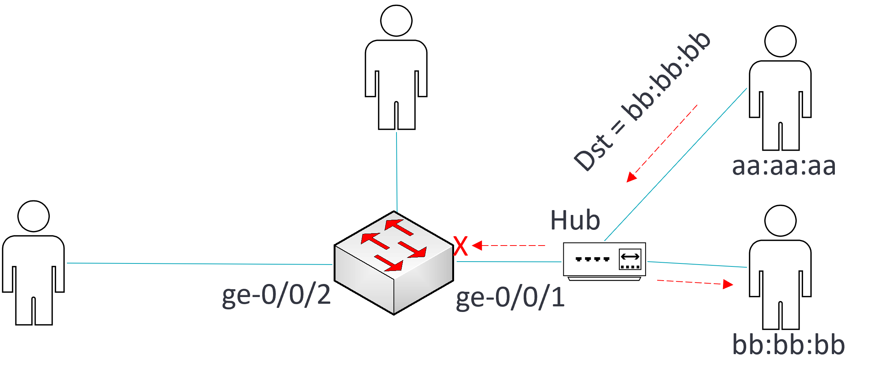
Bridging Mechanisms - Filtering
Filtering is used to limit forwarded traffic to only frames associated with the port or broadcast domain
The switch will discard or filter frames with a destination associated with the same port, or tagged with a VLAN not associated with the port
MAC Address | Interface
00:11:22:aa:aa:aa | ge-0/0/1
00:11:22:bb:bb:bb | ge-0/0/1
00:11:22:cc:cc:cc | ge-0/0/2
Notes:
Indicate that if aa is sending to bb, the switch will filter the frame because it’s destined to an address on the same port

Slide 5
Bridging Mechanisms - Aging
To ensure the switch only forwards frames to active MACs, the switch tracks the time since activity from a source MAC was last seen
The default aging time for inactive MACs is 300 seconds and can be configured using the below command
user@Switch# set protocols l2-learning global-mac-table-aging-time ?
Possible completions:
<global-mac-table-aging-time> System level MAC table aging time (Seconds)

Slide 6
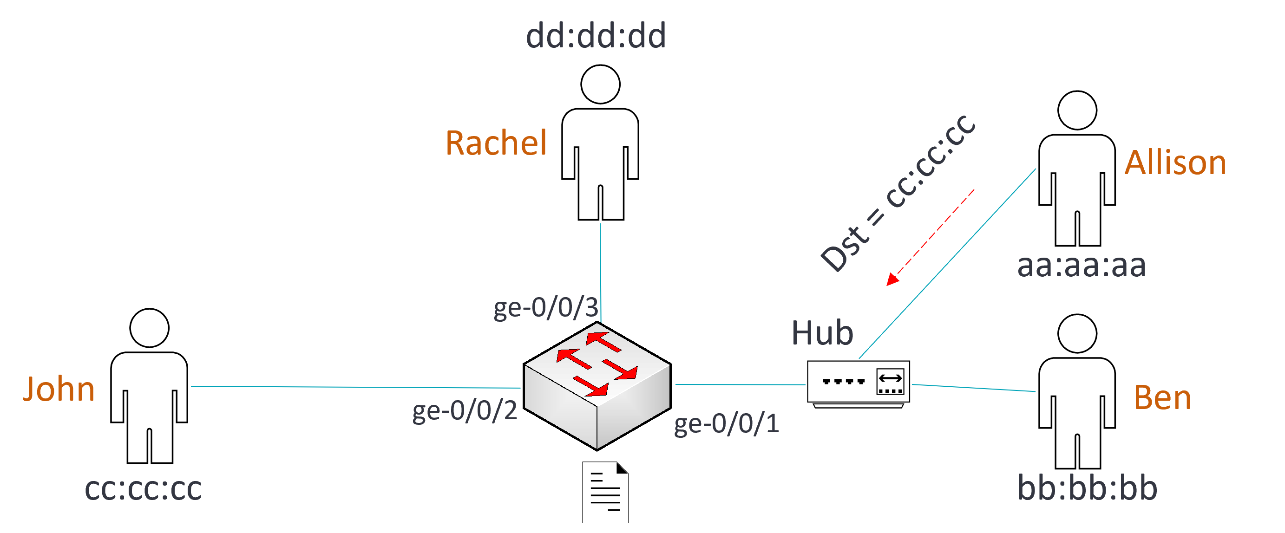
Example Exercise
Using the information below, what users will receive the frame sent by Allison?
Preamble
Destination Address
Source Address
Type
Data
FCS
MAC Address | Interface
00:11:22:aa:aa:aa | ge-0/0/1
00:11:22:bb:bb:bb | ge-0/0/1
00:11:22:dd:dd:dd | ge-0/0/3
Bridge Table

